Slide 1
A New Approach to Analyze the Impact of Active Transportation Programs
Yongping Zhang, Ph.D. California State Polytechnic University, Pomona
Hsi-Hwa Hu, Ph.D. Southern California Association of Governments
June 4, 2019
17th TRB National Transportation Planning Applications Conference

Slide 2
Presentation Outline
Background & Objectives
Methodology
Application

Slide 3
Background
Active Transportation Programs
provide benefits on travel congestion and public health
how to quantify their benefits for planning purposes at both regional and local scale?

Slide 4
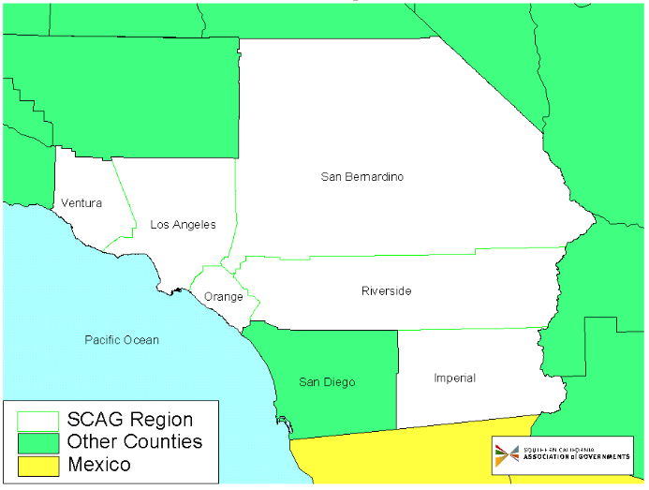
Study Area
SCAG Region
6 counties in Southern California
20 million population
8 million jobs
190+ cities

Slide 5
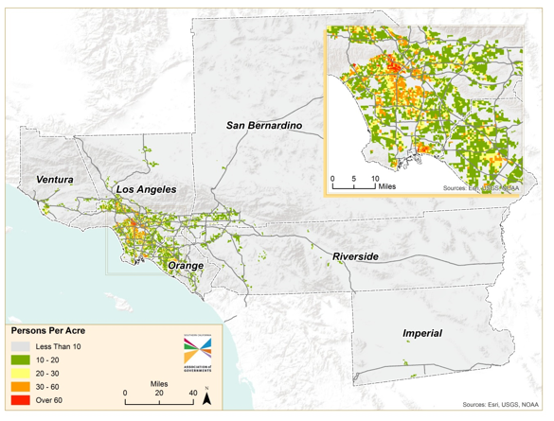
SCAG Region Population Density

Slide 6
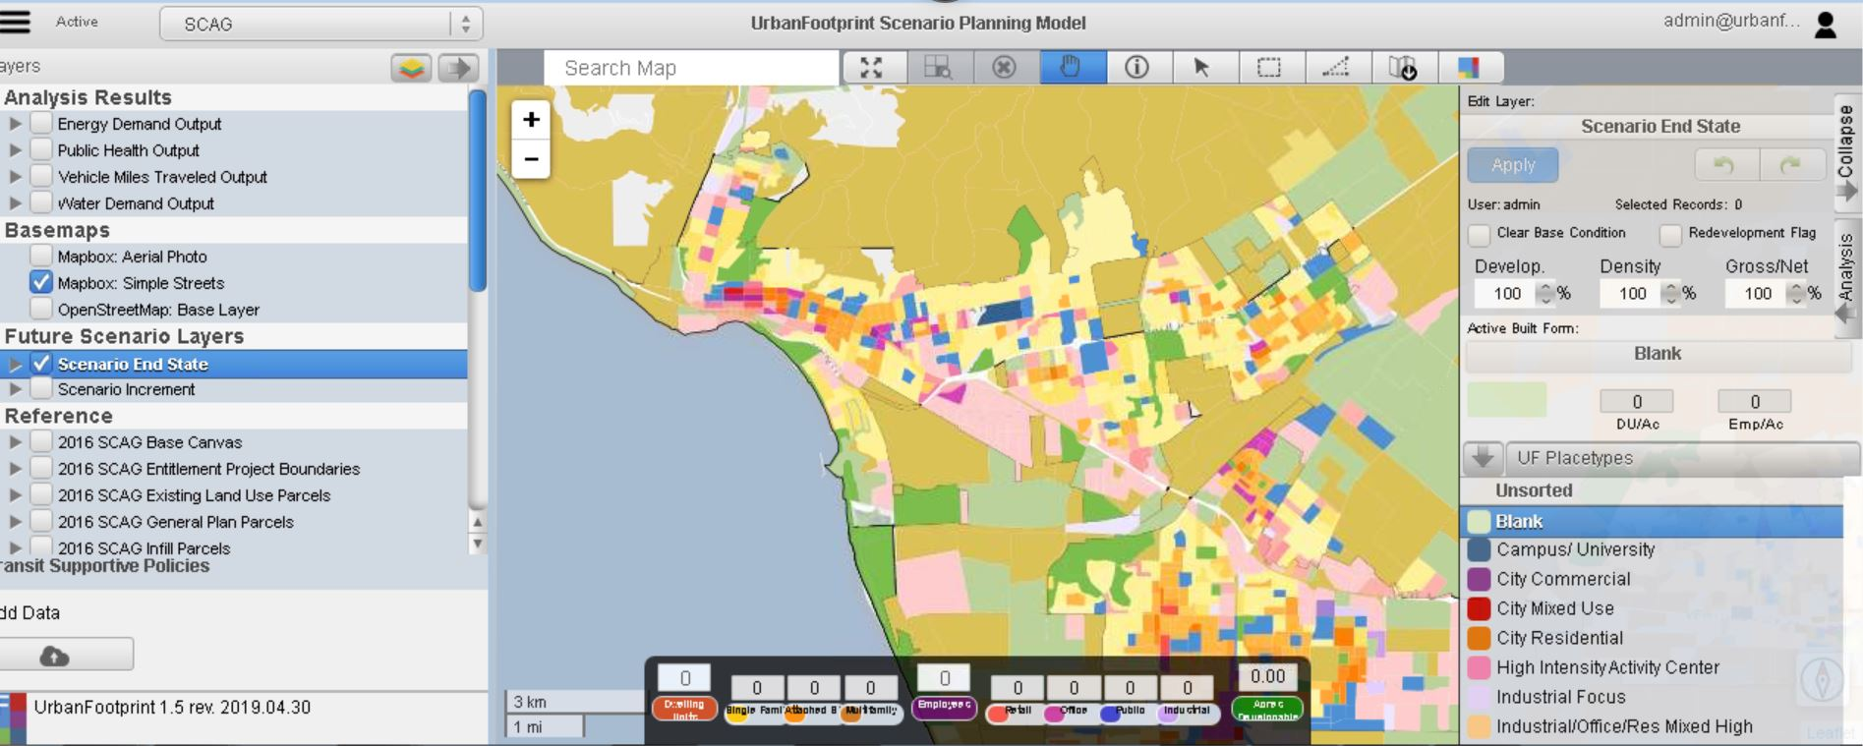
Scenario Planning Model (SPM)
A web-based land use sketch planning tool
Data Management: 125K SPZs (Scenario Planning Zones)
35 Place Types: a generalized land use description based on land use characteristics

Slide 7
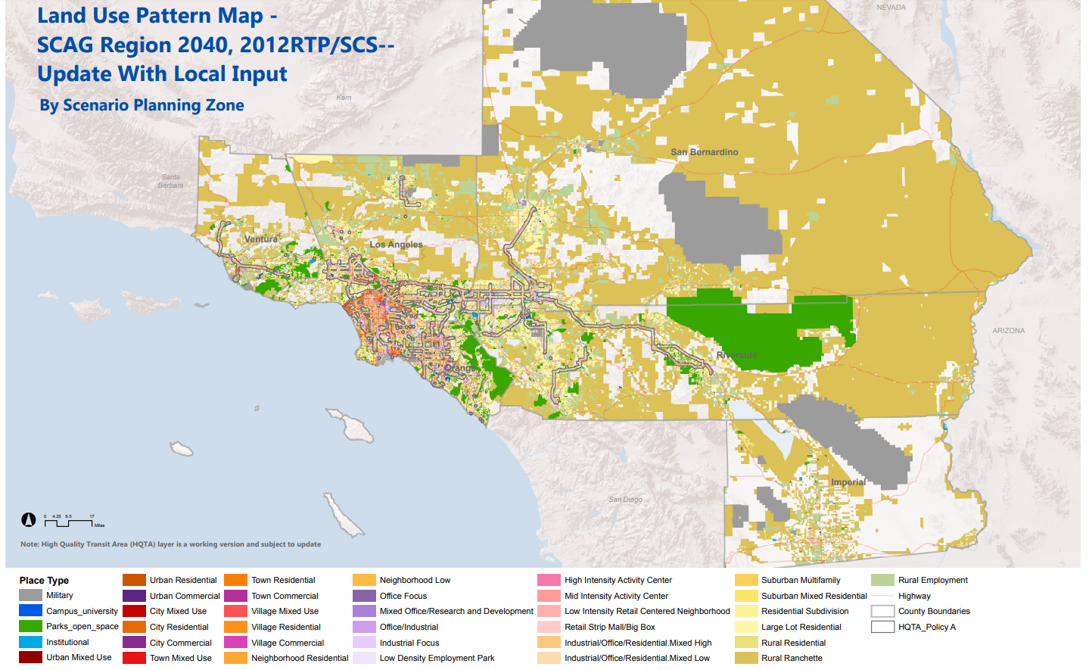
Data in SPZ
Population
Households
Employment
Place Types
Parcel
Zoning
Bike Lane
Major Stops
Boundaries

Slide 8
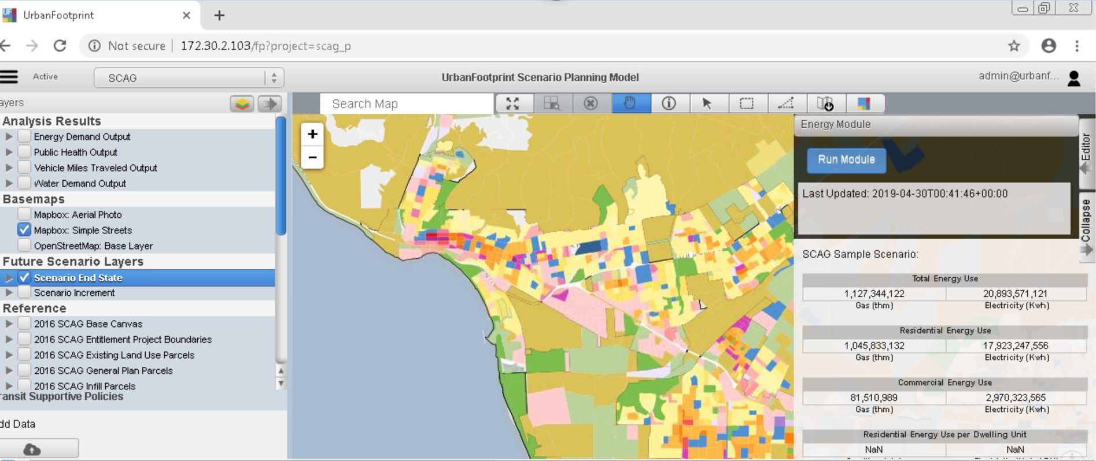
Scenario Planning Model (SPM)
Modules: transportation, water, energy, land consumption, public health

Slide 9
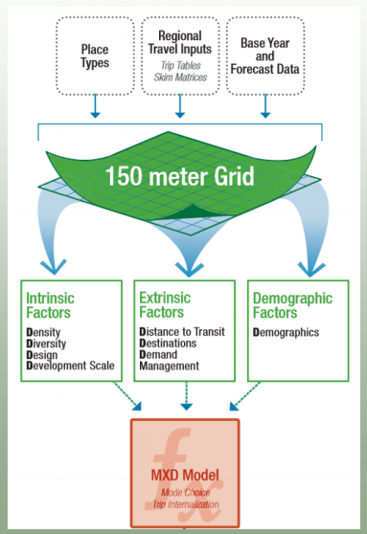
SPM Transportation Module
Using Mixed-Use Trip Generation (MXD) model developed by Fehr & Peers
Generate Mode Choice and VMT for each SPZ
Limitations:
lacks direct sensitivity to active transportation facilities
based on limited data regarding active transportation behavior
walking/biking trips output not accurate
Source: Fehr & Peers

Slide 10
Objectives
Develop an active transportation analytical tool (AT Tool)
to estimate changes in mode share and VMT associated with changes in land use and/or active transportation facilities/programs
at both regional & local scale
AT Facilities:
bike lane, pedestrian, mid-block crossing, street calming
AT Programs:
F/L mile, SRTS

Slide 11
Model Framework
Multinomial logit model (MNL)
Alternatives (modes):
vehicle (base), transit, walk to activities, walk to transit stop, bike
Mode Choice is function of:
Individual/Household Socioeconomic
Land Use Characteristics
Built Environment
AT infrastructure

Slide 12
Variables
Socioeconomic:
Age, worker, household income / size / vehicles
Land Use: density, diversity, place type
Built environment:
Transit stop density, intersection density, street density
AT Infrastructure:
bike lane density

Slide 13
Data Source
2012 California Household Travel Survey (CHTS)
SCAG SPZ: population, employment, etc.
SCAG TAZ: socioeconomic
SCAG Model Network
All data are merged into each SPZ

Slide 14
Model Results
Variables | Transit | Walk-Activity | Walk-Transit | Bike | Variable Description
Constant | -3.5460 | -2.5317 | -3.9949 | -4.4308
worker | -0.3034 | -0.5356 | 0.0000 | 0.0000 | 1=worker; 0=otherwise
kid | 1.3310 | 0.4584 | -0.4354 | 0.5477 | 1=kid (age<16); 0=otherwise
nw1624 | 1.5231 | 0.4805 | 1.2788 | 1.0568 | 1=non worker with age 16-24; 0=otherwise
nw6599 | -0.2803 | -0.1575 | -0.4973 | -0.4580 | 1=non worker with age 65-99; 0=otherwise
HHVEH | -1.0122 | -0.5876 | -1.3362 | -0.4996 | Number of household vehicles
HHSIZE | 0.1739 | 0.1392 | 0.2375 | 0.0769 | Household size
inc1 | 0.8637 | 0.4212 | 0.8007 | 0.0000 | HH Inc , 35K
inc2 | 0.3010 | 0.0000 | 0.2543 | 0.0000 | HH Inc 35-50K
inc5 | 0.0000 | -0.1251 | -0.4581 | 0.0000 | HH Inc 100-150K
inc6 | 0.0000 | 0.1384 | 0.0000 | 0.0000 | HH Inc >150K
int_den | 0.0000 | 0.0013 | 0.0014 | 0.0022 | Intersection density per square mile
mxd_den | 0.000013 | 0.000020 | 0.000025 | 0.000008 | MXD Density: population & employment per square mile
mxd_div | 0.0000 | 0.4891 | 0.2920 | 0.2533 | MXD Diversity Index
LocalD | -13.0639 | 5.5297 | 0.0000 | 9.8925 | Local street density (speed <= 25mph) - mi/acre
ArterialD | 0.0000 | -8.0035 | 0.0000 | 0.0000 | Arterial (speed >= 35mph) - mi/acre
BLden1 |  |  |  | 7.0946 | Bikelane density - mi/acre
StopD | 0.0026 |  | 0.0011 |  | Count of all transit stops within 1 kilometer

Slide 15
Model Input and AT Infrastructure
AT Programs: Additional enhancement
F/L Mile: SPZ within ½ mile buffer of rail stations
SRTS (Safe Route to School): SPZ within school buffer
MODEL INPUT | AT INFRASTRUCTURE
Bike Lane Density | Bike Lane
Intersection Density | Mid-block Crossing
Local Street Density | Street Calming
Place Type | % Sidewalk Coverage

Slide 16
Model Calibration
Model Calibration/Validation:
Model/CHTS for 35 place types
Adjust Constant Term

Slide 17
Sensitivity Test
Conclusion: the elasticities associated with each of the built-environment variables and their coefficients are relatively consistent with published research

Slide 18
Model Application
Local planning analysis
Regional Planning: SCAG 2016 RTP
2012 – 2040: $13 billion AT Plan
Regional Travel Demand Model:
only 0.6% increase on walk share and 0.1% on bike
Using the AT Tool
additional 2.4% increase on walk share, 0.8% on bike share, 0.3% on transit share
additional 0.5% VMT reduction

Slide 19
Next Steps
Use the AT Tool to estimate public health benefits
Integrate the AT Tool into SPM

Slide 20
Thank you
Hsi-Hwa Hu, Ph.D. Yongping Zhang, Ph.D.
Hu@scag.ca.gov yongpingz@cpp.edu
213-236-1834 626-623-0321

